Slide 1

Execution in ROS 2
October 19th, 2021

Slide 2

Overview
Traditional “ROS” Approach
What: Subscriptions, Services Client/Server, Timers, QoS Events
When: Triggering on all Messages, some Messages, Timer, etc.
Where: Proactor/Callback versus Reactor/Polling
How: Reactor Pattern with Wait Sets
How: Proactor Pattern with ROS 2 Executor and Callback Groups
How: Proactor Pattern with DDS Listener API
State of Execution in rclcpp today
Future Work

Slide 3
Traditional “ROS” Approach
User provides callback that is called for each message received.
class MinimalSubscriber : public rclcpp::Node
{
public:
MinimalSubscriber()
: Node("minimal_subscriber")
{
subscription_ = this->create_subscription<std_msgs::msg::String>(
"topic",
10,
[this](std_msgs::msg::String::UniquePtr msg) {
RCLCPP_INFO(this->get_logger(), "I heard: '%s'", msg->data.c_str());
});
}
private:
rclcpp::Subscription<std_msgs::msg::String>::SharedPtr subscription_;
};
int main(int argc, char * argv[])
{
rclcpp::init(argc, argv);
rclcpp::spin(std::make_shared<MinimalSubscriber>());
rclcpp::shutdown();
return 0;
}
void
rclcpp::spin(rclcpp::node_interfaces::NodeBaseInterface::SharedPtr node_ptr)
{
rclcpp::executors::SingleThreadedExecutor exec;
exec.add_node(node_ptr);
exec.spin();
exec.remove_node(node_ptr);
}
https://github.com/ros2/examples/blob/galactic/rclcpp/topics/minimal_subscriber/lambda.cpp

Slide 4
What, When, Where, and How of Execution

Slide 5
What
Subscriptions
A message is received on a topic
Service Servers
A request is received from a Service Client
Service Clients
A response is received from the Service Server
Timers
A timer expired
QoS Events
Deadline missed, liveliness lost, incompatible QoS offered, etc.

Slide 6
When
Proactor
waits for the read/write to be completed
system takes data
e.g. Window’s IOCP API
ROS 2’s executors is an example of Proactor
DDS’s Listener API is an example of Proactor
Reactor
waits for the read/write operation to be ready
user takes data
e.g. select, kqueue, epoll
ROS 2’s and DDS’s “Wait Set” pattern is an example of Reactor

Slide 7
Where (or who takes the data)
ROS 2’s Executor:
Data is taken by the executor and given to the user’s callback.
The consequence of this is that scheduling, i.e. what gets taken first when there multiple things ready, is built into the executor.
Wait Set approach:
Data is taken by the user, after waiting.
Scheduling in this case is handled by the user.

Slide 8
How
Reactor Pattern using a wait set
auto do_nothing = [](std_msgs::msg::String::UniquePtr) {assert(false);};
auto sub1 = node->create_subscription<std_msgs::msg::String>(
"~/chatter", 10, do_nothing);
auto sub2 = node->create_subscription<std_msgs::msg::String>(
"~/chatter", 10, do_nothing);
auto guard_condition1 = std::make_shared<rclcpp::GuardCondition>();
auto guard_condition2 = std::make_shared<rclcpp::GuardCondition>();
// ...
rclcpp::WaitSet wait_set(
std::vector<rclcpp::WaitSet::SubscriptionEntry>{{sub}},
{},
std::vector<rclcpp::GuardCondition::SharedPtr>{guard_condition1});
// ...
wait_set.add_subscription(sub2);
wait_set.add_guard_condition(guard_condition2);
auto wait_result = wait_set.wait(std::chrono::seconds(1));
if (wait_result.kind() == rclcpp::WaitResultKind::Ready) {
// iterate over ready subscriptions, guard conditions, etc and handle them
for (size_t i = 0; i < subscriptions_num; i++) {
if (wait_result.get_wait_set().get_rcl_wait_set().subscriptions[i]) {
RCLCPP_INFO(node->get_logger(), "subscription %zu triggered", i + 1);
std_msgs::msg::String msg;
rclcpp::MessageInfo msg_info;
if (sub_vector.at(i)->take(msg, msg_info)) {
RCLCPP_INFO(
node->get_logger(),
"subscription %zu: I heard '%s'", i + 1, msg.data.c_str());
} else {
RCLCPP_INFO(node->get_logger(), "subscription %zu: No message", i + 1);
}
}
}
} else if (wait_result.kind() == rclcpp::WaitResultKind::Timeout) {
RCLCPP_INFO(node->get_logger(), "wait-set waiting failed with timeout");
} else if (wait_result.kind() == rclcpp::WaitResultKind::Empty) {
RCLCPP_INFO(node->get_logger(), "wait-set waiting failed because wait-set is empty");
}
https://github.com/ros2/examples/blob/447580d858999170337676164fb1e582ffcefd00/rclcpp/wait_set/src/wait_set.cpp

Slide 9
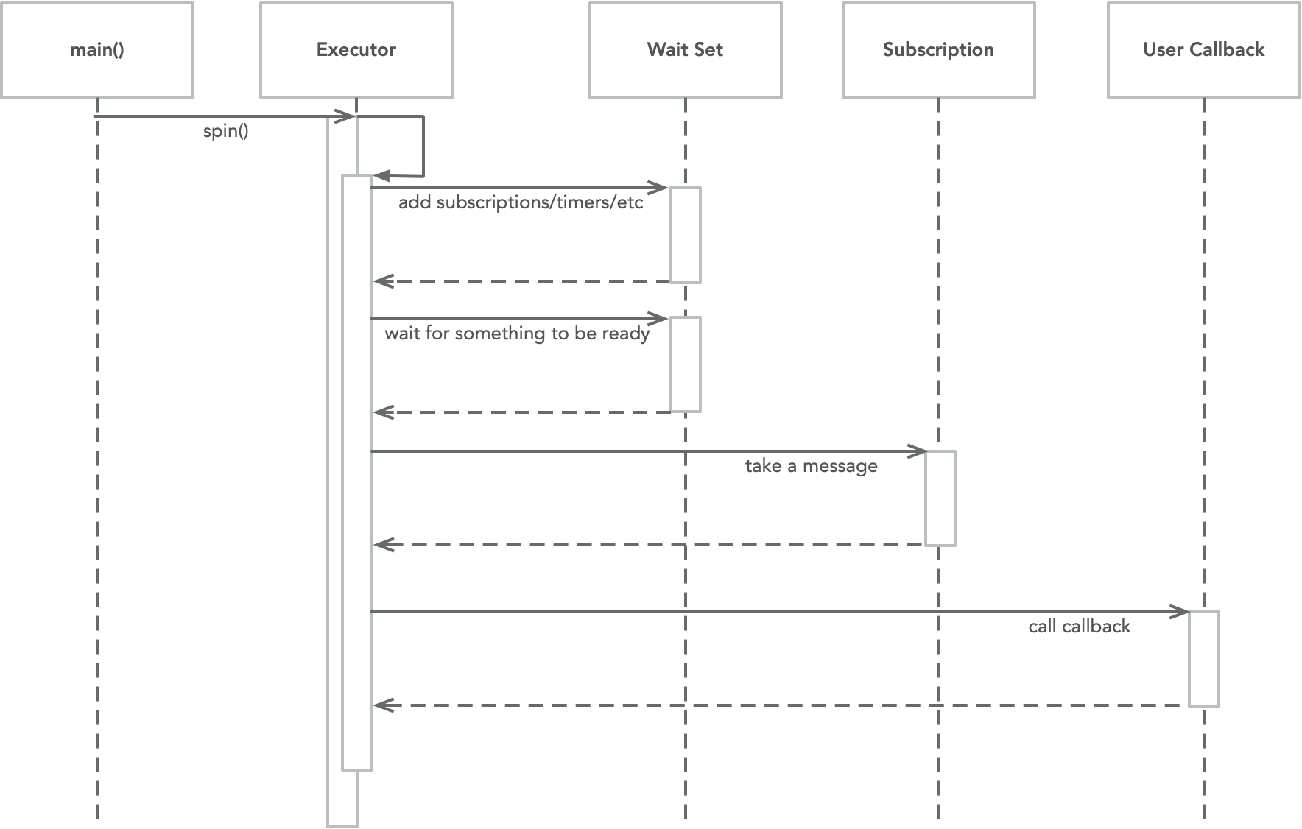
How
Executor uses Reactor pattern to provide Proactor pattern

Slide 10
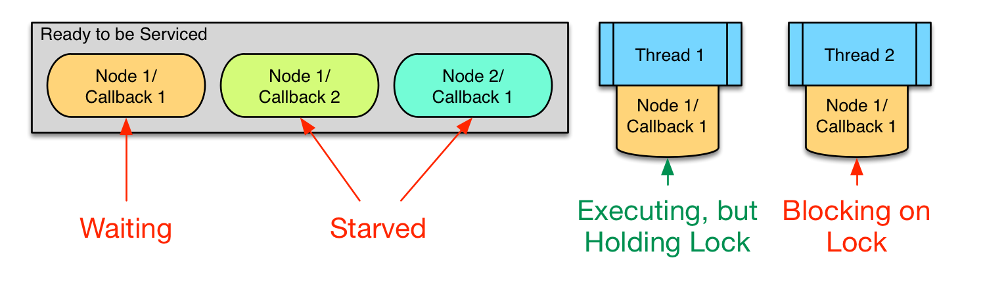
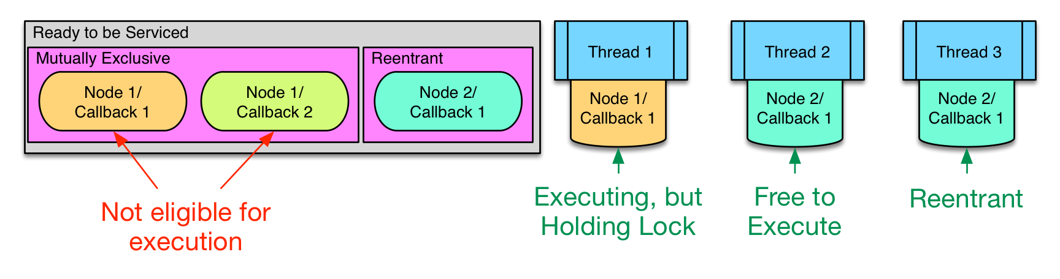
How
Why callback groups?
Avoid starvation by letting user hint to executor what tasks are mutually exclusive.

Slide 11
What’s Next?

Slide 12
State of Execution in rclcpp today
SingleThreadedExecutor
MultiThreadedExecutor
StaticSingleThreadedExecutor
Drawbacks:
No (easy) exposed scheduling
rmw/rcl wait set interface inefficient
only supports simple callback options (e.g. triggered only on new messages)

Slide 13
Future Work
Replace current SingleThreadedExecutor with design used in StaticSingleThreadedExecutor
Reimplement MultiThreadedExecutor and StaticSingleThreadedExecutor using rclcpp::WaitSet
Experiment with rclcpp::WaitSet based on upcoming “listener”-style rmw API
Include more kinds of executor designs in rclcpp and document which to use when for various use cases

Slide 14
Questions

